Slide 1
Quantum Simulation
A simple approach with Ising model

Slide 2
Contents
A short review of quantum simulation
01
Ising model, Partition function, and some thermodynamic property
02
03
Quantum simulation of Ising model

Slide 3
01
Review of quantum simulation

Slide 4

MISSION STATEMENT
Goal
Simulating the time evolution with given Hamiltonian
$$\left.|ψ(t)\right\rangle =exp⁡(−i\hat{H}t)\left.|ψ(0)\right\rangle$$

Slide 5



Three Basic Step
step1
step2
step3
step4
Initialization:
Direct preparation(Easiest)
Write $\hat{H}$ under second quantization
Hamiltonian Evolution:
Four step:
Use Suzuki-trotter approximation to simplify $exp⁡(−i\hat{H}t)$
Map creation/annihilation operator (anticommute) to pauli matrix(commute) by Jordan-Wigner transfrom.
Data Extraction:
Measure Expected Value
$${{e^{−iU^{+}HUt}=U}^{+}e}^{−iHt}U$$

Slide 6
02
Ising Model

Slide 7
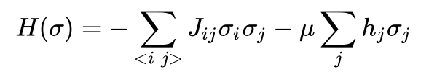
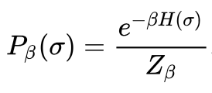
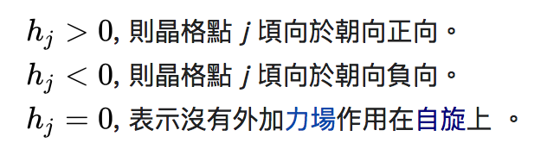
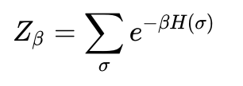
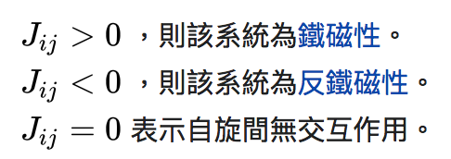
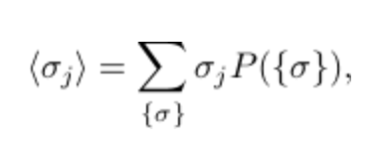
Hamiltonian and Boltzmann Distribution

Slide 8
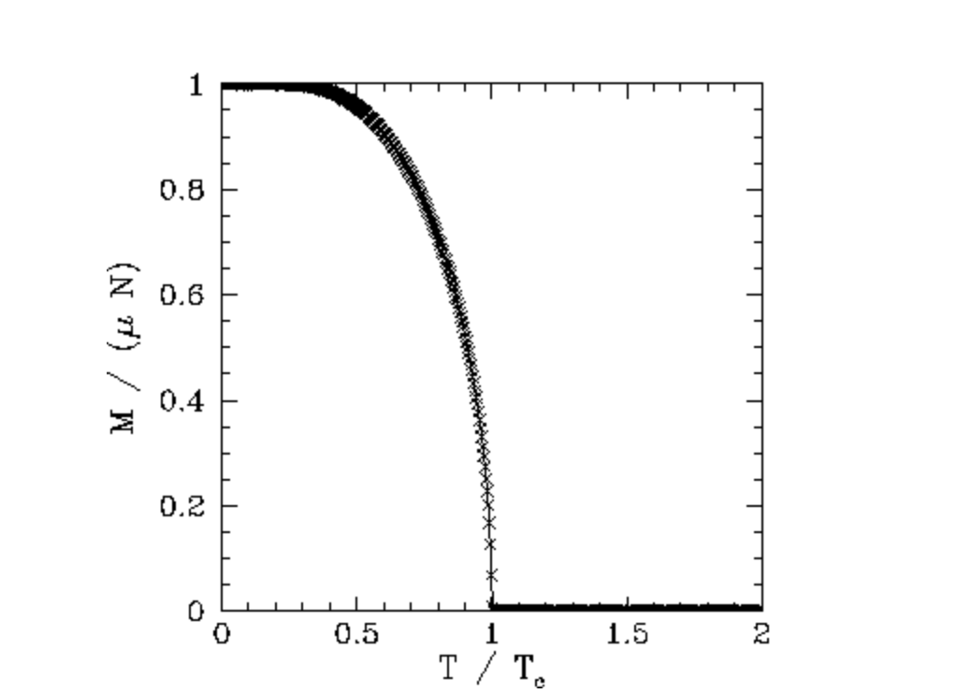
Phase Transition

Slide 9
03
Quantum simulation of 4bit Ising model

Slide 10




Hamiltonian
step1
Write $\hat{H}$ under second quantization
$$H=−J(Z_{1}Z_{2}+Z_{2}Z_{3}+Z_{3}Z_{4}+Z_{1}Z)−h(Z_{1}+Z_{2}+Z_{3}+Z_{4})$$
step2
$$e^{−iHt}=e^{Jt\left(Z_{1}Z_{2}+Z_{2}Z_{3}+Z_{3}Z_{4}+Z_{1}Z\right)−ht\left(Z_{1}+Z_{2}+Z_{3}+Z_{4}\right)}$$
$$=e^{JZ_{1}Z_{2}t}e^{JZ_{2}Z_{3}t}e^{JZ_{3}Z_{4}t}e^{JZ_{4}Z_{1}t}e^{hZ_{1}t}e^{hZ_{2}t}e^{hZ_{3}t}e^{hZ_{4}t}$$
Use Suzuki-trotter approximation to simplify $exp⁡(−i\hat{H}t)$
step3
Map creation/annihilation operator (anticommute) to pauli matrix(commute) by Jordan-Wigner transfrom.
step4
$${{e^{−iU^{+}HUt}=U}^{+}e}^{−iHt}U$$

Slide 11






Partition Function
$$Z_{β}=\sum_{σ}{e^{−βE(σ)}}=2^{n}\sum{P\left(E_{i}\right)e^{−βE_{i}}}$$
$$e^{−iHt}H^{⨂n}|{\left.0\right\rangle }^{⨂n}=\frac{1}{\sqrt{2^{n}}}\sum_{x}{e^{−iHt}}|\left.x\right\rangle$$
$$=\sum{\sqrt{P\left(E_{i}\right)}e^{−iE_{i}t}}|\left.E_{i}\right\rangle$$
$$\left|\left.ψ\right\rangle =H^{⨂n}\right|{\left.0\right\rangle }^{⨂n}=\sum{\sqrt{P\left(E_{i}\right)}}|\left.E_{i}\right\rangle$$
$${\left\langle ψ|\right.e}^{−iHt}|\left.ψ\right\rangle =\sum{\sqrt{P\left(E_{i}\right)}}|\left.E_{i}\right\rangle ∙\sum{\sqrt{P\left(E_{i}\right)}e^{−iE_{i}t}}|\left.E_{i}\right\rangle =\sum{P(E_{i})e^{−iE_{i}t}}$$
Let K(E,t)= ${\left\langle ψ|\right.e}^{−iHt}|\left.ψ\right\rangle$, partion function can be derived by Fourier transform of K (energy spectrum)
(Substitute t by $β$)

Slide 12
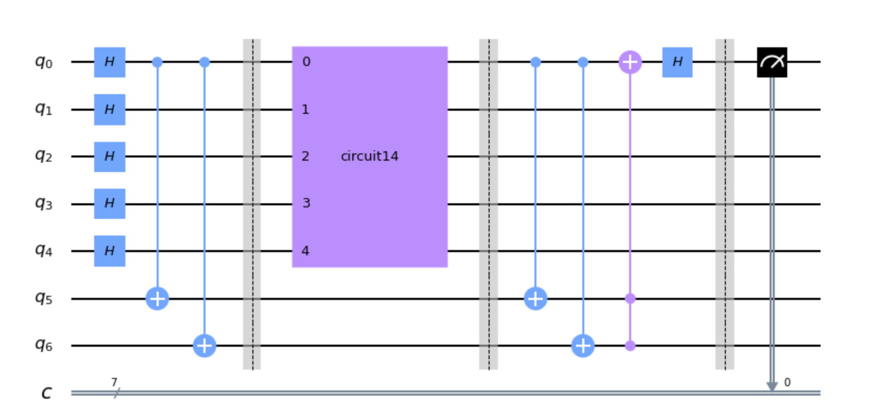


Design
H
H
$$|\left.0\right\rangle$$
m
$$|\left.ψ\right\rangle$$
U
P(0)-P(1)=Re{<U>}

Slide 13
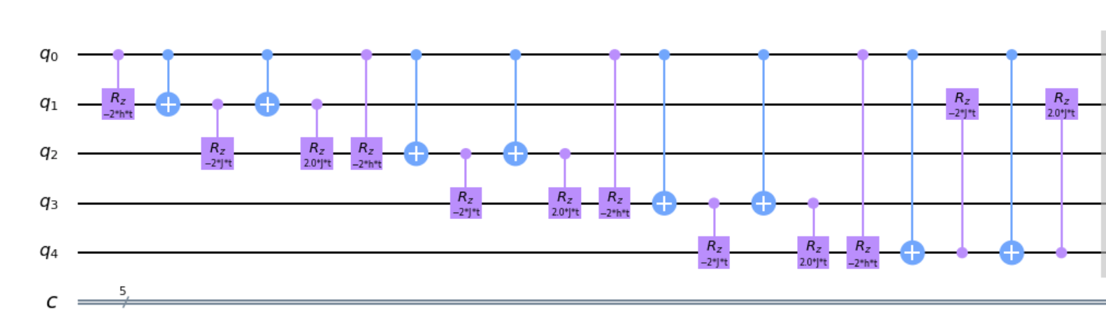
Design

Slide 14
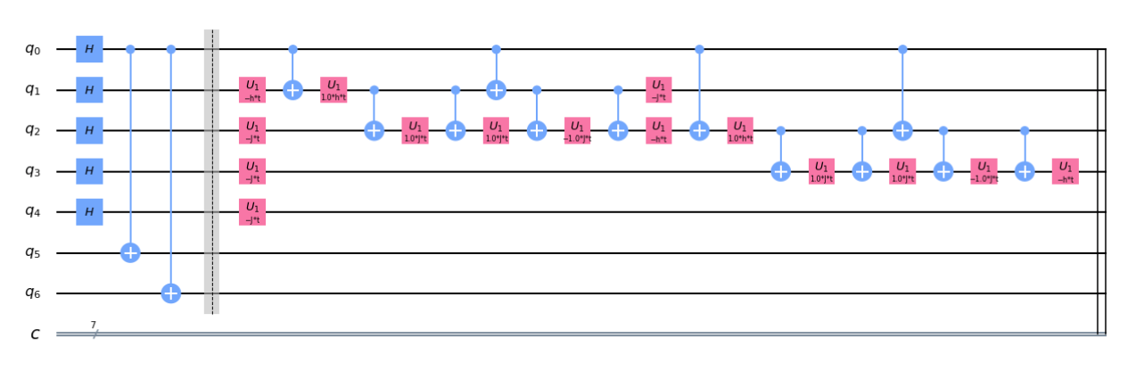
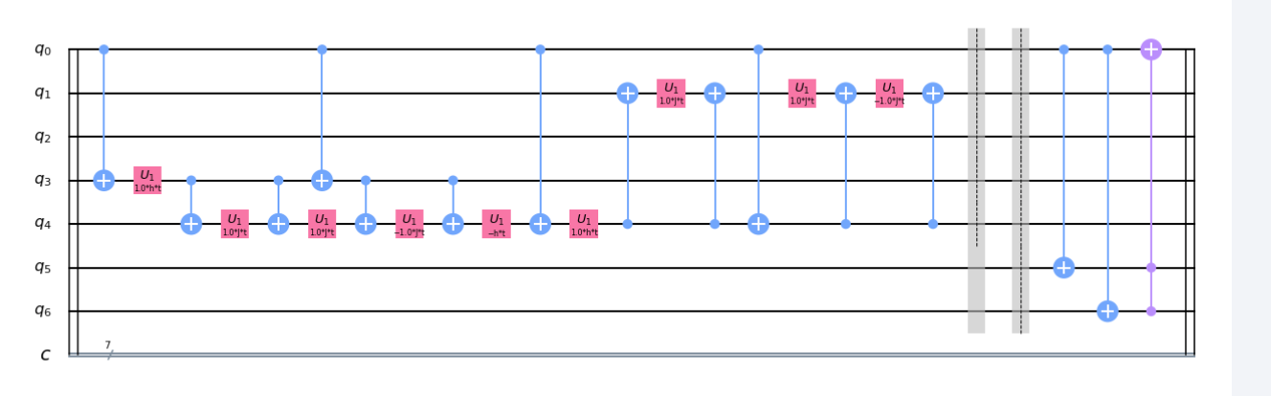
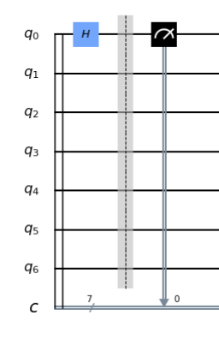
Layout_Top

Slide 15
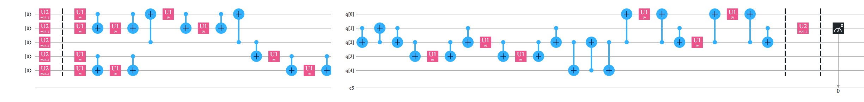
Layout_Bottom

Slide 16
Result: Simulating Partition Function

Slide 17
Future plan
Simulation of magnetization value
01
More qubit (deal with long control distance problem)
02
03
2D,3D model (complex control sequence)

